Slide 1
canary islands climate case study
Presented by:

Slide 2
Physical Location
Canary islands is one of the areas in Spain with the warmest climate.
The area is sectioned in to two regions, east and west.
The western region consists of Tenerife, Gran Canaria, La Palma, La Gomera, and Ferro islands, with mountain peaks erected from a subterranean ocean floor.
The eastern group comprises Lanzarote, Fuerteventura Island, and submarine plateau, the Canary Ridge, (Rodriguez, 2019).
Notes:
Canary Islands are approximately 100 km from the African coast, and 1000 km from peninsular Spain.

Slide 3
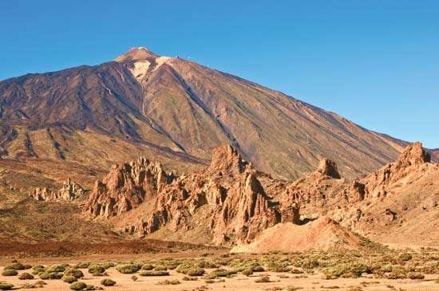
Geology
Canary islands were formed from volcanic activities.
The western regions rises up to 4000 feet.
The eastern region having its highest at 12,198 feet.
The entire region is dominated by mafic rocks, (Rodriguez, 2019).
Notes:
Picture of Teide Peak in Tenerife, Canary Islands.

Slide 4
Climate Outline
The climate of Canary Islands, is averaged monthly for provinces as representation of Canary Islands and a few instances covering the entire island’s averages. The points of interest that sum up the subtropical climate include;
Temperatures.
Precipitation (Rainfall & Humidity).
Amount of sunshine.
Wind speeds.

Slide 5
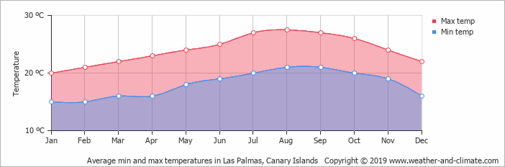
1. Temperatures
January, February, March, April, May, June, November And December are most likely to experience best weathers with an attractive average temperatures that fall between 20 degrees and 25 degrees, (World Weather & Climate, 2019)
Notes:
The warmest month is August and the coolest month is January.

Slide 6
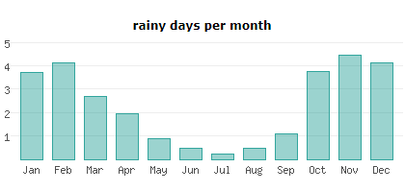
2. PRECIPITATION
Rainfall
Rainy days per month vary, where precipitation becomes high during the end and beginning of the year.
The month with the highest average rainy days is approximately 5 days, with the lowest being below 1 day, (WorldData, 2019).
Notes:
November is the wettest month in terms of rainfall.
July is the driest month in terms of rainfall.

Slide 7
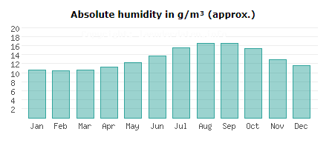
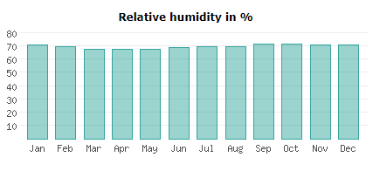
2. PRECIPITATION
b) Humidity
Based on the rainfall statistics, the amount of relative and absolute humidity is a reflection of averages in the amount of rainfall.
The average percentages are illustrated as follows, (WorldData, 2019)

Slide 8
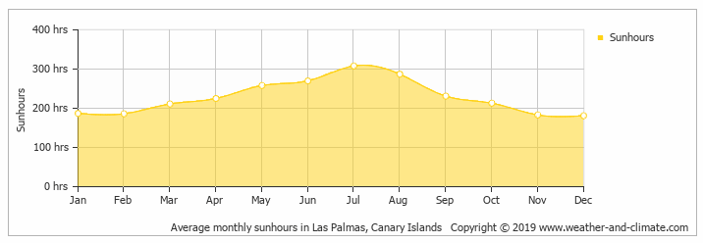
3. AMOUNT OF SUNSHINE
Being the one of the warmest places on earth, it is estimated that the island receives an average of 250 hours of sunshine per month, (World Weather & Climate, 2019)
Notes:
July and August receives the most sunshine, while November, December, January and February receive the least sunshine.

Slide 9
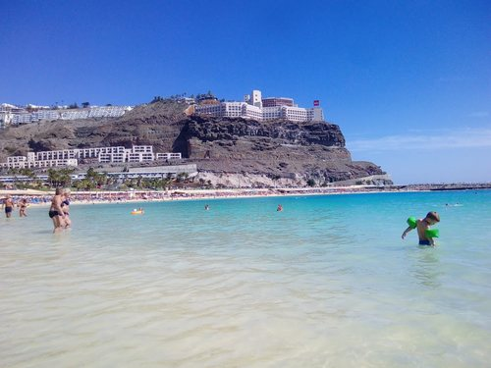
3. WIND SPEEDS
According to Moira, (2018), the most windy areas in Canary Island are Lanzarote and Fuerteventura, while the least windy areas are South-West of Gran Canaria, and some parts of Tenerife.
Notes:
All areas in the Canary Islands are windy, however, shielded beaches are found to be less windy than open beaches, as illustrated in the picture.
Picture of shielded beach; Playa Amadores.

Slide 10
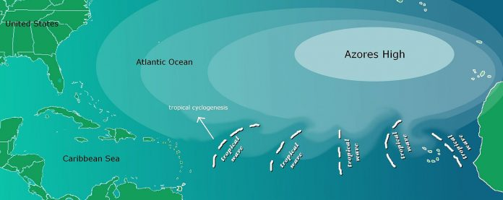
Factors that Influence the Type of Climate in Canary Islands
There are two main factors that influence the climate in Canary Islands,; Trade winds, North Atlantic Oscillation and the Geography.
Trade Winds.
The trade winds come from the northern polar region where they meet the Azores Anticyclone, to form as stable mass of air around the region. The effect can be an elaborative explanation to the warm temperatures throughout the year, (StarExcursions, 2019).
Notes:
Picture illustrating Azores High’s zone of influence over the Atlantic Ocean

Slide 11
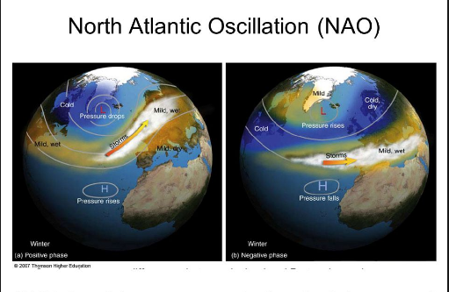
Factors that Influence the Type of Climate in Canary Islands
North Atlantic Oscillation.
The outstanding factor is a concept influenced by winds, where atmospheric pressure difference changes at sea level between Icelandic Low and the Azores High.
The concept has a direct correlation with the amount of rainfall received in at least 5 areas within the Canary Islands, (Herrera. et al, 2001)
Notes:
North Atlantic Oscillation, can either be positive or negative based on the movement of winds.

Slide 12
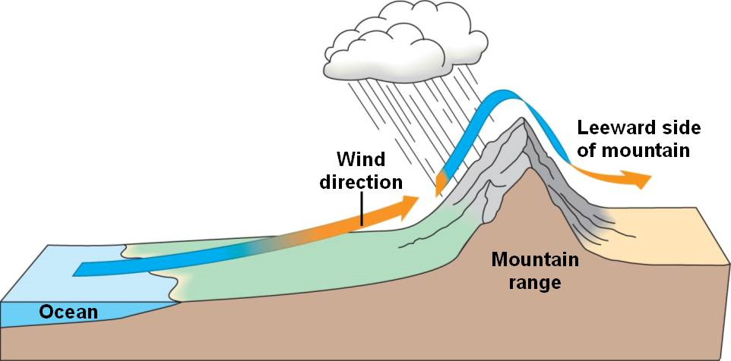
Factors that Influence the Type of Climate in Canary Islands
Geography.
Due to the geographical nature of the islands being mountainous, the northern parts tends to be wet and cool while the south remains dry and hot. (Bramwell, 2018).
Notes:
The Northern parts are higher than Southern areas.
Applies the concept of windward and leeward sides of a mountain.

Slide 13
References
Rodriguez, 2019. Canary Islands. Retrieved from; https://www.britannica.com/place/Canary-Islands
Moira, 2018. Tips For Your "DIY Holidays" Based On My Experiences. Least Windy Canary Island. Retrieved from; https://www.travelling.cloud/2018/08/least-windy-canary-island.html?m=1
World Weather & Climate, 2019. Climate And Average Monthly Weather In Puerto Rico (Canary Islands), Spain. Retrieved from; https://weather-and-climate.com/average-monthly-Rainfall-Temperature-Sunshine,puerto-rico,Spain
WorldData, 2019. Climate for Canary Islands (Spain). Retrieved from; https://www.worlddata.info/europe/spain/climate-canary-islands.php
StarExcursions, 2019. The trade winds: what influence do they have over the Canary Islands? Retrieved from; http://starexcursions.com/en/the-trade-winds/
Herrera, et al, 2001. Influence of the North Atlantic Oscillation on the Canary Islands Precipitation. Journal Of Climate, 14(19), 3889-3903. doi: 10.1175/1520-0442(2001)014<3889:iotnao>2.0.co;2
Bramwell, 2018. What factors affect the weather in the Canary Islands? Retrieved from; https://www.quora.com/What-factors-affect-the-weather-in-the-Canary-Islands

Slide 14
THE END

